Slide 1

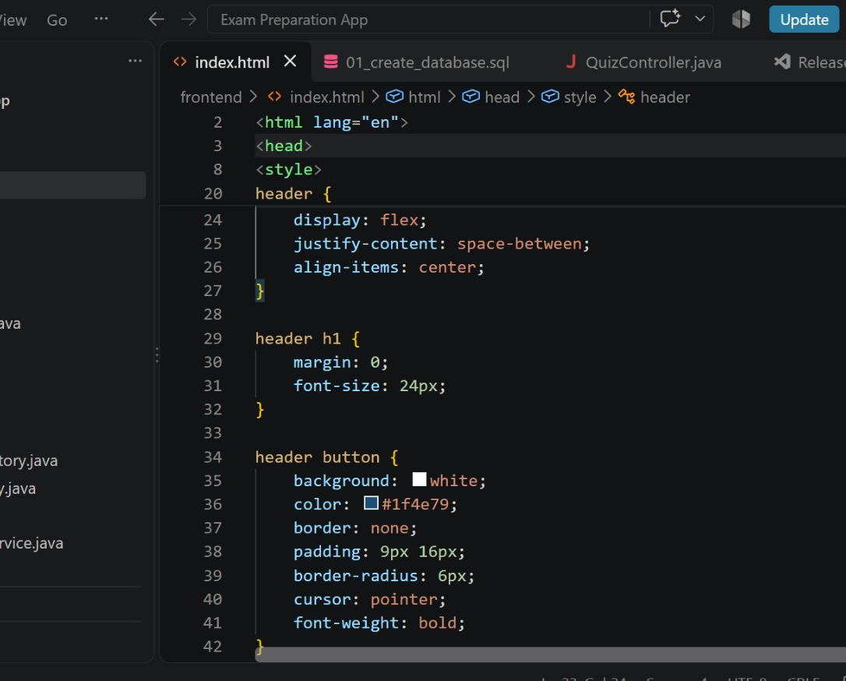
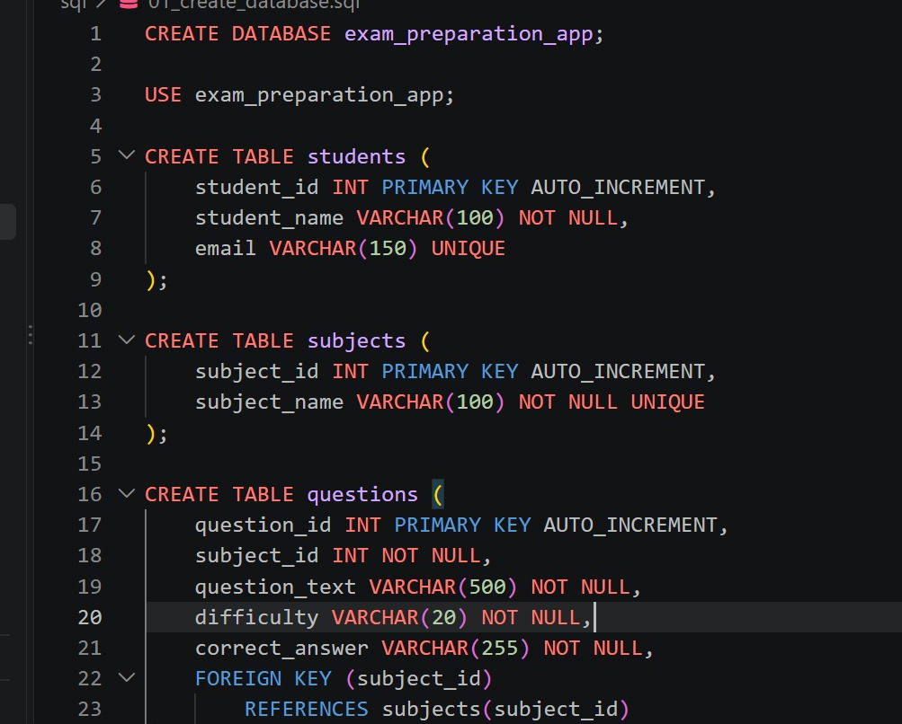

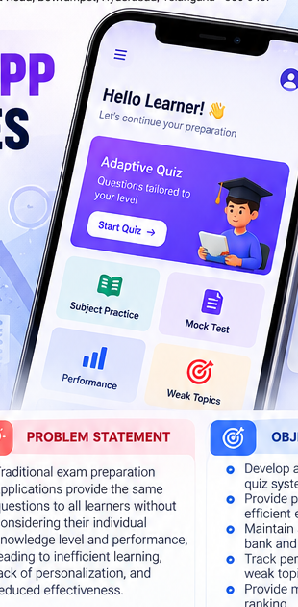
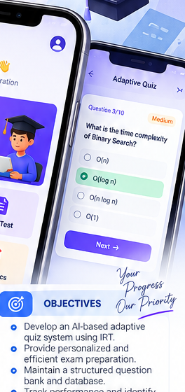
EXAM PREPARATION APP WITH ADAPTIVE QUIZZES
Team ID: 3 | Section: 7 | Members: Konda Vaishali – 2520030117, P. Bindhu Madhavi – 2520030077, Nava Harsha – 2520030493 | Guide: Dr.Spandana
Database Systems Engineering and Distributed Backend Development (25CS1302E) | KLH Bachupally Campus, CSE | PBL 2026-27
Abstract
Tools & Technologies
• Android-based exam-preparation app providing personalized quizzes. Item Response Theory (IRT) dynamically adjusts question difficulty using learner responses and estimated ability.
• Includes question bank management, adaptive quizzes, performance analytics, weak-topic detection, mock tests, peer ranking, Room Database and Firebase.
• Android Studio — development environment
• Kotlin — programming language
• Android SDK — application components
• Jetpack Compose — UI design
• Room Database — local storage
• Firebase — cloud storage & authentication
• SQL — database operations
• Item Response Theory (IRT) — adaptive learning
• Git & GitHub — version control; Postman — API testing
Problem Statement & Objectives
• Problem: Traditional exam-preparation applications provide the same questions to all learners without considering individual knowledge level and performance, leading to inefficient learning and reduced personalization.
• Objective 1: Develop an AI-based adaptive quiz system using IRT.
• Objective 2: Provide personalized and efficient exam preparation.
• Objective 3: Maintain a structured question bank and database.
• Scope: Question bank, adaptive quizzes, performance analytics, weak-topic detection, mock tests and peer ranking for Android learners.
System Architecture
User Interaction
Adaptive Quiz
Engine (IRT)
Database Layer
Room + Firebase
Existing vs Proposed System
Analytics / Weak
Topic Detection
Mock Test +
Peer Ranking
Feature | Existing System | Proposed System
Adaptive questions | Same questions for all learners | IRT-based questions tailored to learner ability
Practice | General practice | Subject-wise practice + weak-topic detection
Assessment | Limited personalization | Adaptive quizzes + scheduled mock tests
Analytics | Basic / non-personalized | Performance, accuracy and learning-pattern tracking
Gap | No individual adaptation | Adaptive engine + personalized recommendations
ER Diagram & Database Design
Database design represented in the source poster:
• Room Database for local storage
• Firebase for cloud storage & authentication
• SQL operations, ACID transactions, indexing and query optimization
• Entity-level ER diagram was not provided in the source poster.
Feasibility Study
• Technical: Android Studio, Kotlin, Android SDK, Jetpack Compose, Room Database, Firebase and SQL operations are used.
• Economic: Uses an open-source development stack and cloud-based Firebase services; no paid infrastructure is specified in the source poster.
• Operational: User-friendly Android interface with personalized quizzes, analytics, weak-topic detection and mock tests.
• Schedule: Designed as a PBL 2026–27 project with implementation, testing and future expansion planned.
Implementation Screenshots
Results & Testing
Conclusion
Future Scope
• Adaptive quizzes successfully implemented using Item Response Theory (IRT).
• Accurate assessment of learner performance and knowledge level.
• Weak-topic detection enables personalized practice.
• Reliable database operations using Room, SQL and Firebase; indexing and query optimization are included.
• The project delivers an Android-based personalized exam-preparation application with adaptive quizzes, analytics, mock tests and peer comparison.
• It addresses the stated objectives through IRT-based adaptation, structured question management and performance tracking.
• Support more subjects and competitive examinations.
• Integrate advanced AI/ML techniques for enhanced adaptivity.
• Improve recommendation systems using learning patterns.
• Expand to web for wider accessibility and add gamification.
• Enhanced analytics, collaborative learning and larger-scale cloud deployment.
References: [1] Project poster supplied by the team [2] Technologies listed in the project poster (Android Studio, Kotlin, Room, Firebase, IRT)
GitHub
QR not provided

